Slide 1
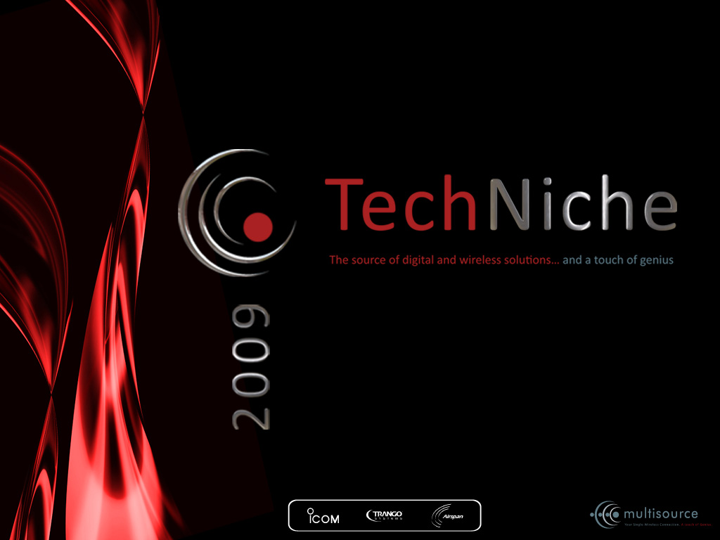
ICOM IDAS
DIGTAL PROFESSIONAL MOBILE RADIO

Slide 2
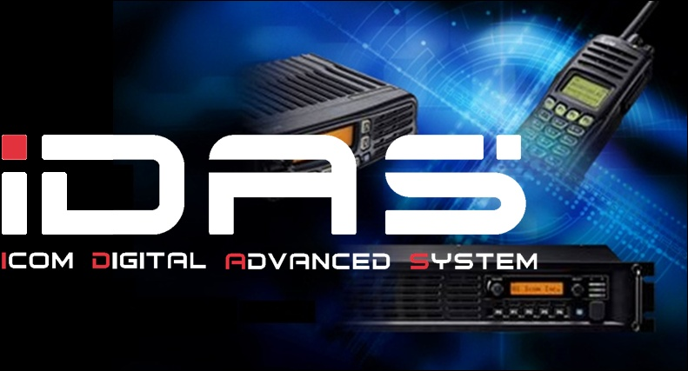
IDAS FROM ICOM
IDAS bridges the gap between analog and digital systems

Slide 3
Why Digital?
We are living the Digital Revolution

Slide 4



IDAS Technology
Advanced Narrowband Technology in a Broadband World
Contrary to other markets like the Internet or cellular, Land Mobile Radio (LMR) is going NARROWBAND
Radio spectrum is full or approaching capacity, requiring more spectrum efficient technologies
Digital technology allows for more application flexibility despite reduced bandwidth
The FCC in the U.S.A. mandated the adoption of 6.25kHz or equivalent technology to increase spectrum efficiency
We wish NXDNTM to become a de-facto digital standard
25kHz
12.5kHz
6.25kHz
Icom’s Solution:
IDAS
6.25kHz channel spacing can ONLY be achieved with digital technology
25kHz and 12.5kHz possible with analog technology

Slide 5



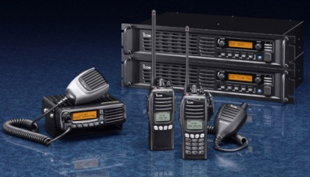
Narrowband Trends Worldwide
United States already allows and licenses narrowband technology
Europe has two narrowband standards, and is developing another now
China has tentatively decided to utilize and standardize two narrowband digital technologies for LMR use
Japan has initially allocated spectrum for license-free digital narrowband
The release of IDAS has prompted other countries to look into adopting narrowband digital radio technology
IDAS:
A New Technology with
Worldwide Potential

Slide 6

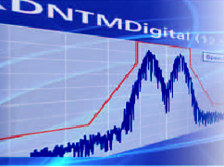



IDAS Advantages
5 Initial Benefits of the IDAS System
Flexible migration path from analog to digital
Digital/analog mixed mode operation
Protect your current system investment
Doubles channel capacity (2x 6.25kHz Ch. in 12.5kHz Ch.)
Create two offset 6.25kHz channels in a 12.5kHz spacing
No reduction in channel capacity even with peer-to-peer
Improved audio quality and coverage over analog
AMBE+2™codec for clear audio with data communication
Better sensitivity and greater communication coverage
Improved communication security
15-bit digital encryption keys standard (about 32,000 keys)
Flexible application possibilities now and in the future
Variety of selective callings and data communications
Network interface for repeater is available

Slide 7
Analog to Digital Migration
IDAS lets you migrate to a digital system as you please
The IDAS radio can receive both analog mode and digital mode signals on a single channel
You can partially introduce the IDAS radios, while using the existing analog radios in a system
The IDAS system allows you to scale migration to narrow band digital at your own pace and need, while running your existing analog system
It is a cost efficient way to obtain the next generation in two way radio technology, while protecting your current system investment

Slide 8
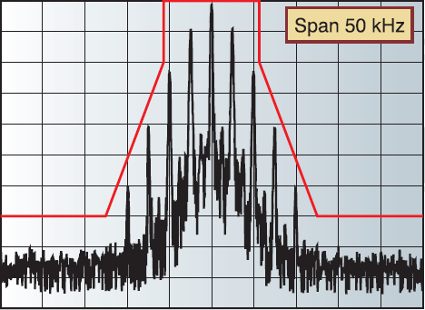
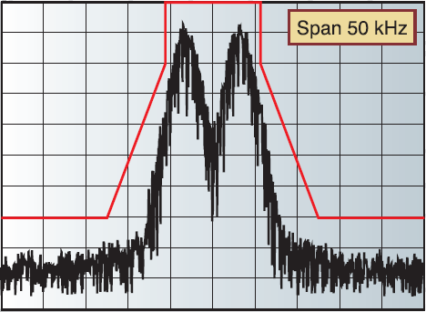


Double Current Channel Capacity
The 6.25kHz channel spacing in digital mode allows you to use two channels in current 12.5kHz channel allocation
Existing Analog FM
(12.5kHz)
IDAS Digital
(6.25kHz)
Two offset 6.25kHz
channels are available
12.5kHz traffic image
6.25kHz digital image
2x the traffic of 12.5kHz

Slide 9
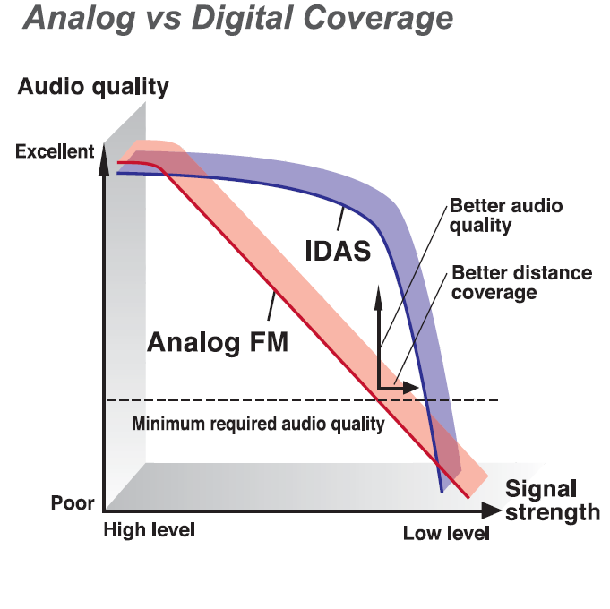
Audio & Coverage: Another Dimension!
Utilizing the latest AMBE+2TM Vocoder technology, the IDAS system’s audio quality is superior to FM analog

Slide 10
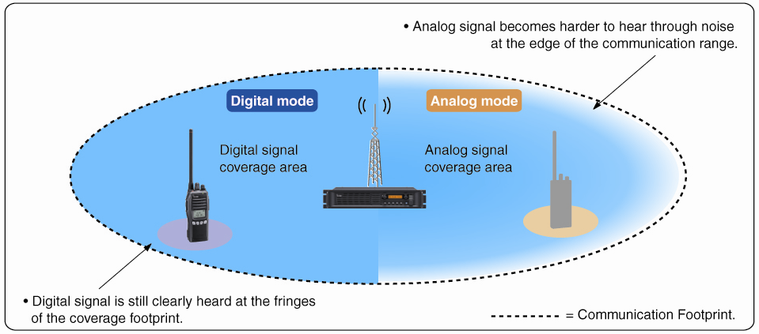
Audio & Coverage: Another Dimension!
End user reports to date indicate roughly a 20% increase in coverage compared to FM analog
End users also report a lack of noise in mobile communications environment in digital mode

Slide 11
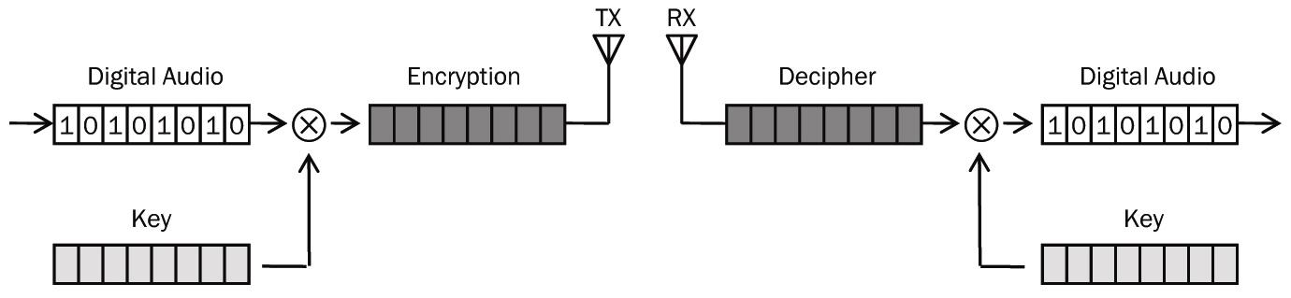
Communications Security
A 15-bit encryption feature is built into the IDAS system
This encryption allows you up to approximately 32,768 codes for a high level of communications security
All communication completely unintelligible when receive by an analog radio

Slide 12
Flexible Application Possibilities
IP Interconnect Network Applications

Slide 13

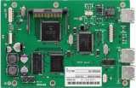
IDAS System Evolution Path
Single Site
IDAS™ Conventional
IDAS™ Trunking
IC-FR5000/FR6000 IDAS™ Digital Repeater
IDAS™, 6.25kHz digital mode ready
Two RF modules in one unit configurable
Upgradable to Trunking or IP Networking
Current IDAS™ radios are compatible with IDAS™ Trunking and IDAS™ IP Networking
IC-FR5000/FR6000 IDAS™ Digital Repeater
UC-FR5000 #01
Trunking Controller
Multi-Site
IDAS™ Conventional IP Network
IDAS™ Multi-Site Trunking
IC-FR5000/FR6000 IDAS™ Digital Repeater
*Upgradable
Currently under testing
UC-FR5000 #02
Network Controller
Multi-Site Conventional Version
*Detailed specifications and required options have not been finalized yet.

Slide 14
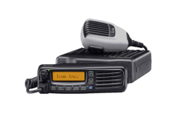






Single Site Trunking
The IDAS™ trunking system is a distributed system which does not use a dedicated control channel. Every channel can be used for voice communications
  Up to 30 channels per site
  Trunking Controllers can be daisy-chained
  Supports all IDAS™ call functions e.g. Individual call, Talkgroup call, All call
  Group ID and Unit ID are selectable within the range of 1 to 2,000 ID numbers
  Cost effective trunking system
CH1
CH2
IP
CH3
Remote Setting
CH30
BUS

Slide 15

Single Site Trunking Application
Covering heavy communication traffic in a metropolitan area
  Single-Site Trunking allow effective channel management by sharing a minimum of channels with a large number of users.
  IDAS™ trunking minimizes the waiting time for an open channel
  Selective call, group call and all call makes for effective, efficient communication
  IDAS™ trunking is a cost effective system



Trunking Site

Slide 16









IDAS Conventional IP Network
The IDAS™ Conventional IP Network provides a self-contained affordable repeater interlinking solution.
Up to 16 repeaters can be IP-interconnected.
Install the UC-FR5000 #02 in each repeater for instant IP connectivity
In a typical internet environment, single IDAS voice stream is estimated to require approx.13kbps only due to the fact that it is digitally compressed.
The IDAS™ Conventional IP Network repeaters may be programmed to have a different “Channel Group” to have separate networks.
The IDAS™ conventional IP Network system does not require a control server.
Subscriber units can operate in the same manner with single site conventional operation
Site A
Site C
IP Network
IDAS™ Remote Communicator
Site B
IDAS™ Remote Communicator

Slide 17
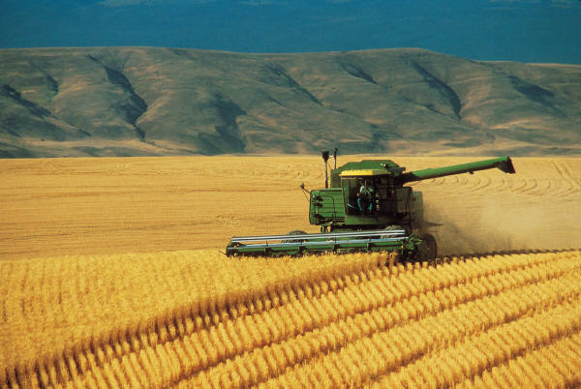






Conventional IP Network Application
Communication Link for Locations Separated by Distance
Corn field
Preprocessing facility
IP
IP
Internet / WAN
Benefits:
No expensive microwave link or
UHF/VHF link is required
No sound quality degradation
No long delay in a multi-hop link
Up to 16 sites can be linked
Factory
IP

Slide 18




Conventional IP Network Application
In-Building / Intra-Building Network
Internet / WAN
LAN
LAN
Basement
Basement
Radios can be used anywhere
Dispatcher can be anywhere

Slide 19



Conventional IP Network Application
Receiver Voting
Benefits:
Expand the communication coverage area of terminals, but especially handheld radios Seamless connection within the coverage area
The dispatcher can be anywhere
Easy to establish a Receiver Voting system
  No extra voter is required. The Network Controller at repeater site acts as the voter
Repeater Site
(Tx & Rx)
Receiver Site C
(Rx only*)
IP Network
Receiver Site A
(Rx only*)
Receiver Site B
(Rx only*)
Dispatcher
(Remote Communicator)

Slide 20

Conventional IP Network Application
Cross-Band Repeater
UHF Network
VHF Network
IP Network
Dispatch Console
(Remote Communicator)
Dispatch Console
(Remote Communicator)
Benefits:
No third party interlinking equipment necessary
Low cost dispatchers, which can be located anywhere
No voice degradation
Additional utilization of two separate systems for increased total communication efficiency
Potentially integrate two independent systems when required

Slide 21

Conventional IP Network Application
Strip-line Coverage for Freeways
IP Network
Benefits:
Eliminate site-interlinking RF frequency license and equipment
Seamless connection while driving along the strip-line
Dispatchers can be easily added at minimal cost
Simple system architecture suitable for low/mid level voice traffic strip-line coverage radio communication system
No voice quality degradation
No limit to communication range

Slide 22




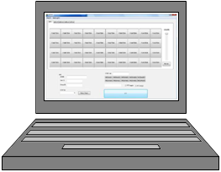

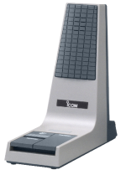



IDAS Remote Communicator
The RC-FS10 IDAS™ Remote Communicator
The RC-FS10 Remote Communicator creates an IP-connected virtual radio (dispatcher) on a Windows PC which may be located anywhere an appropriate IP connection is available
The CT-24, Digital Voice Converter unit, has an ESN which can be used for identification of a unit. The PC software will not work if the CT-24 is not connected
The SM-25 desktop microphone can be used via the CT-23. PTT button of the SM-25 works as when connected to a regular radio. A PC headset can also be used. PTT function is provided by a screen button in case a PC headset is used
Repeater
Repeater
SM-25
Network
Controller
Network
Controller
CT-24
CT-23
IP Network
Repeater
IDAS™ Remote Communicator
Network
Controller

Slide 23

IDAS Remote Communicator
The RC-FS10 IDAS™ Remote Communicator
The RC-FS10 works as if it is a terminal radio located close to a specified repeater (set target repeater IP address to listen / uplink voice)
Up to eight virtual radios can be IP-connected to a repeater
Each CT-24 Digital Voice Converter handles one voice path. Multiple down-link voice streams of different network can be heard at the same time on the same PC up to the number of connected CT-24
Repeater
Repeater
Up to 8 Remote Communicators per Repeater
IP Network
Up to 8 Remote Communicators per Repeater
Repeater
Up to 8 Remote Communicators per Repeater

Slide 24
IDAS Remote Communicator
The RC-FS10 IDAS™ Remote Communicator
The PC software will provide minimum set of programmable dispatcher console-like functions as well as simple repeater control such as changing channel / repeater site
SDK / API documentation for third party developers will be available under agreement so that third party developers can make IDAS™ compatible products
We intend to encourage third party developers to supply customer-specific dispatcher solutions to meet various types of customer needs
Such third party products will be under control due to the fact that the CT-24 Digital Voice Converter unit is indispensable to use the SDK / API to handle the voice traffic in each console / voice path
Details of disclosure / licensing conditions will be determined later

Slide 25
IDAS Remote Communicator
IDAS PC Command Firmware

Slide 26
PC Command Firmware
Made IDAS ready for Dispatch Applications
Suitable features for the Dispatch Console are:
Individual and Group Call for voice and data
Receive Messages, Status and GPS data
Transmit Max. 100 character messages
Poll Status / GPS data
Stun, Kill and Revive a radio
Remote Monitor / Radio Check

Slide 27
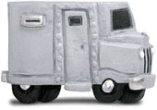
PC Command Firmware
Features in AVL applications
GPS position data can be sent together with:
Voice Call
Status (Power ON and Power OFF can be included)
SDM
Call Alert
Emergency
ManDown
Transmit GPS position data to a fixed station
Transmit GPS position data periodically without user interaction
Ideal for the high security application such as an armored truck

Slide 28
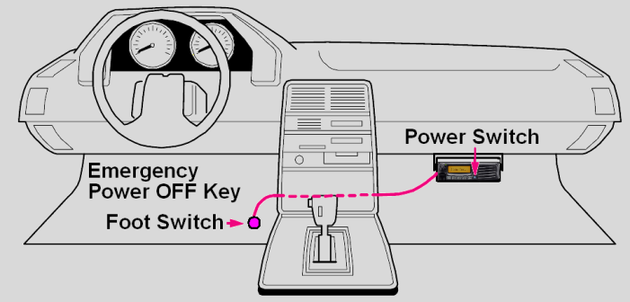
PC Command Firmware
Newly added Emergency Features
Emergency Power Off:
When the radio is shut down by means of the Emergency Power Off feature
The radio appears to be in a normal ‘power off’ condition
An emergency signal is sent to the base station
The radio can accept a ‘Remote Monitor’ command
Send GPS position data with Emergency Signal:
Sent to the base station for exact location of the vehicle

Slide 29
PC Command Firmware
Newly added Security Features
Protect Radios from Unauthorised Use:
Auto Key-Lock
Radios can now be automatically Key-Locked after a set time period has passed without operation in normal mode
Clone Read/Write Password
Up to 16 character password can be set to prevent radio programming and reading of the programmed content

Slide 30
Future Developments
Full Multi-Site Digital Trunking with Seamless Roaming

Slide 31
Thank you

